Slide 1
Agile Development

Slide 2
Outline
What is Agility?
Agility and the Cost of Change
What is Agile an Agile Process?
Extreme Programming (XP)
Other Agile Process Models
A Tool Set for the Agile Process

Slide 3
What is Agility?
Dictionary Definition: ability to move quickly and easily.
An agile team is a nimble team able to appropriately respond to changes.
Changes in the software being built
Changes to the team members
Changes because of new technology
Changes of all kinds that may have an impact on the product they build or the project that creates the product
Software engineers must be quick on their feet if they are to accommodate the rapid changes that Jacobson describes.

Slide 4
What is Agility?
But agility, in the current context, is more than an effective response to change.
It encourages team structures and attitudes that make communication (among team members, between technologists and business people, between software engineers and their managers) more facile.
It emphasizes rapid delivery of operational software and de-emphasizes the importance of intermediate work products (not always a good thing); it adopts the customer as a part of the development team and works to eliminate the “us and them” attitude that continues to pervade many software projects; it recognizes that planning in an uncertain world has its limits and that a project plan must be flexible.

Slide 5
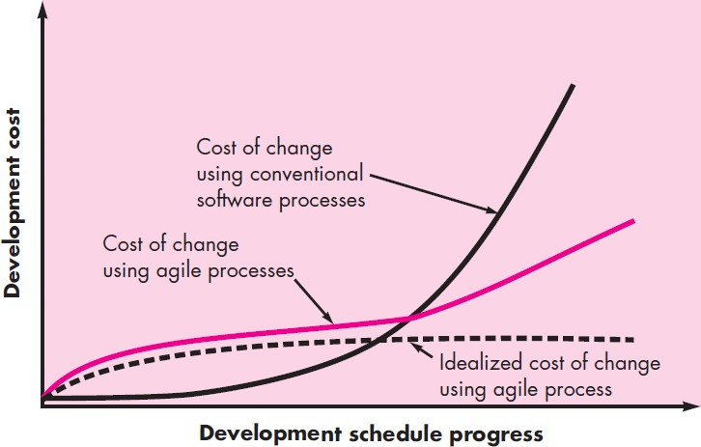
Agility and the Cost of Change

Slide 6
What is Agile an Agile Process?
Any agile software process is characterized in a manner that addresses a number of key assumptions about the majority of software projects:
It is difficult to predict in advance which software requirements will persist and which will change. It is equally difficult to predict how customer priorities will change as the project proceeds
For many types of software, design and construction are interleaved. That is, both activities should be performed in tandem so that design models are proven as they are created. It is difficult to predict how much design is necessary before construction is used to prove the design
Analysis, design, construction, and testing are not as predictable (from a planning
point of view) as we might like.
Given these three assumptions, an important question arises: How do we create a process that can manage unpredictability?

Slide 7
What is Agile an Agile Process?
The answer (of the question arisen in the last slide) lies in process adaptability (to rapidly changing project and technical conditions). An agile process, therefore, must be adaptable.
But continual adaptation without forward progress accomplishes little. Therefore, an agile software process must adapt incrementally.

Slide 8
What is Agile an Agile Process?
Agility Principles
The Agile Alliance defines 12 agility principles (for those who want to achieve agility):
Our highest priority is to satisfy the customer through early and continuous delivery of valuable software.
Welcome changing requirements, even late in development. Agile processes harness
change for the customer’s competitive advantage.
Deliver working software frequently, from a couple of weeks to a couple of months, with a preference to the shorter timescale.
Business people and developers must work together daily throughout the project.
Build projects around motivated individuals. Give them the environment and support
they need, and trust them to get the job done.
The most efficient and effective method of conveying information to and within a development team is face-to-face conversation.

Slide 9
What is Agile an Agile Process?
Agility Principles
The Agile Alliance defines 12 agility principles (for those who want to achieve agility):
Working software is the primary measure of progress.
Agile processes promote sustainable development. The sponsors, developers, and users should be able to maintain a constant pace indefinitely.
Continuous attention to technical excellence and good design enhances agility.
Simplicity—the art of maximizing the amount of work not done—is essential.
The best architectures, requirements, and designs emerge from self– organizing teams.
At regular intervals, the team reflects on how to become more effective, then tunes
and adjusts its behavior accordingly.

Slide 10
What is Agile an Agile Process?
Human Factors
A number of key traits must exist among the people on an agile team and the team itself
Competence
Common focus
Collaboration
Decision-making ability
Fuzzy problem-solving ability
Mutual trust and respect
Self-organization

Slide 11
Extreme Programming (XP)
Extreme Programming (XP)
the most widely used approach to agile software development
XP Values
Communication
Simplicity
Feedback
Courage
Respect

Slide 12
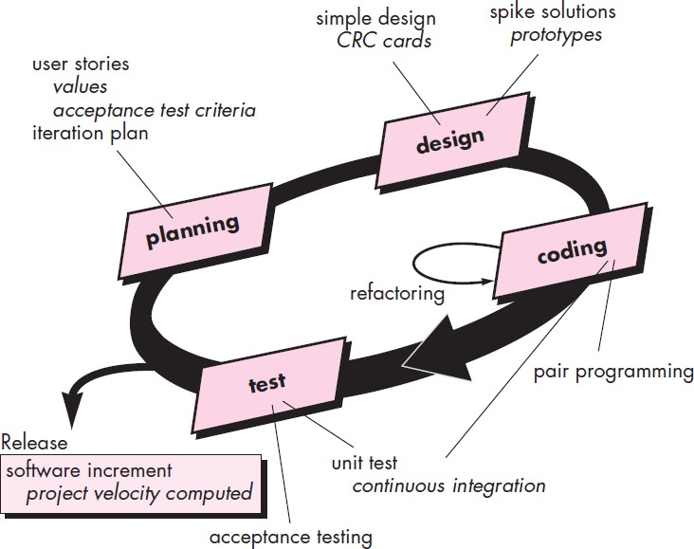
Extreme Programming (XP)
Extreme Programming (XP)
the most widely used approach to agile software development
The XP Process

Slide 13
Other Agile Process Models
Other Agile Process Models
Adaptive Software Development (ASD)
Scrum
Dynamic Systems Development Method (DSDM)
Crystal
Feature Drive Development (FDD)
Lean Software Development (LSD)
Agile Modeling (AM)
Agile Unified Process (AUP)

Slide 14
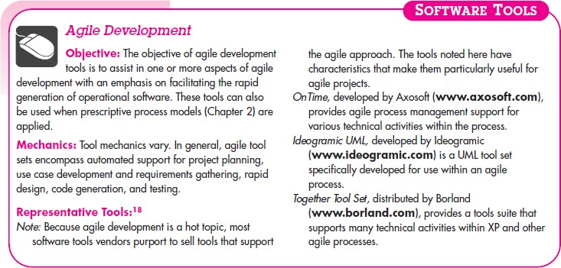
A Tool Set for the Agile Process

Slide 15
References
Roger Pressman, “Software Engineering: A Practitioner’s Approach”,
McGraw-Hill, 7th Edition, 2016

Slide 16
Thank You

